Slide 1
Microsoft Dynamics 365 and Power Platform Conference

Slide 2
Migration of the Data Realms: Dynamics 365 Finance and Operations Odyssey

Slide 3



Rachel Profitt
Principal Program Manager, Business Process Excellence Lead, Functional Fellow
Microsoft
Rachel.Profitt@microsoft.com
https://Dynamics365Lady.com
https://twitter.com/rachelprofitt
https://linkedin.com/in/rachelprofitt
https://youtube.com/c/Dynamics365Unboxed

Slide 4



Nathan Clouse
Technical Architect
Caf2Code LLC
Microsoft Business Applications MVP 4X
www.atomicax.com
www.dynamics.fo
NathanClouseAX on LinkedIn, Twitter, few others

Slide 5
Agenda
Welcome and Overview
Understanding Dynamics 365 and Its Data Landscape
The Challenges of Data Migration
Data Management Framework (DMF)
APIs for Data Migration
Recurring Integrations
Logic Apps and Automation
OData for Real-Time Data Access
Dual-Write for Synchronized Data
Data Preparation and Cleansing
Migration Planning and Execution
Testing and Validation
Wrap-Up and Key Takeaways
Addressing Common Questions

Slide 6

The One Thing!
Golden Config +
Data Migration Process
=
Transaction Data Set

Slide 7

Understanding the Datascape
Notes:
Overview of Dynamics 365
Key components and data architecture
Rachel / Nathan

Slide 8
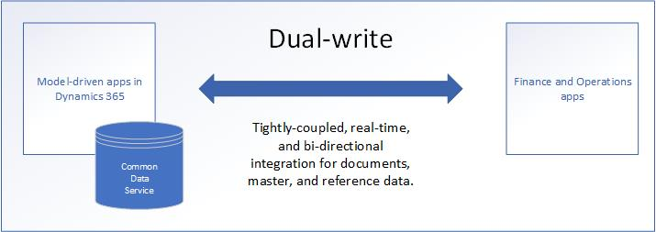
Overview of Dynamics 365 Data

Slide 9
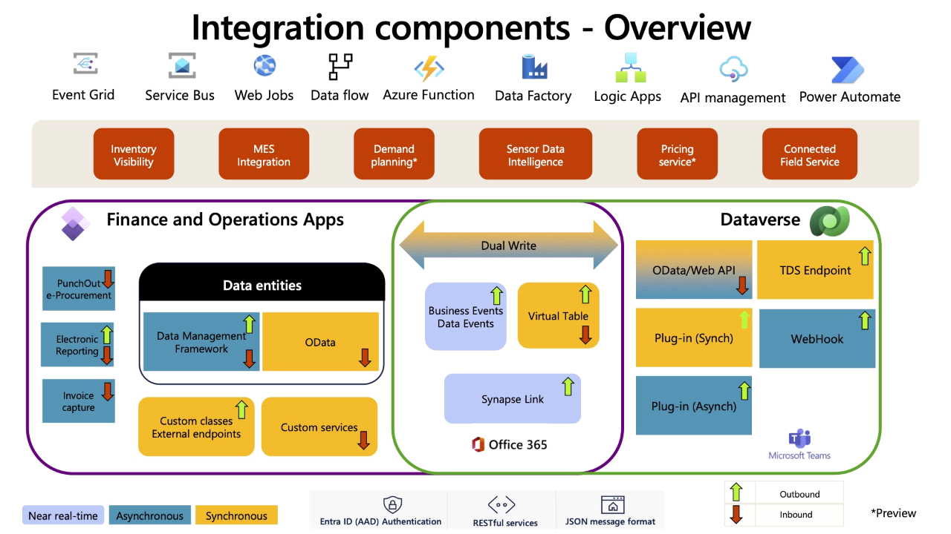
Overview of Dynamics 365 Data

Slide 11
Overview of Dynamics 365 Data

Slide 12
Data Management Scenarios
Data migration from legacy systems
Initial configuration of new implementation from a blank environment
Copy data between environments
Sharing data across legal entities
Copy company configuration within an existing environment
Golden Config
Forward
Pre-Go-Live
Forward
Post-Go-Live
Backward
Sharing
Copying LE’s

Slide 13
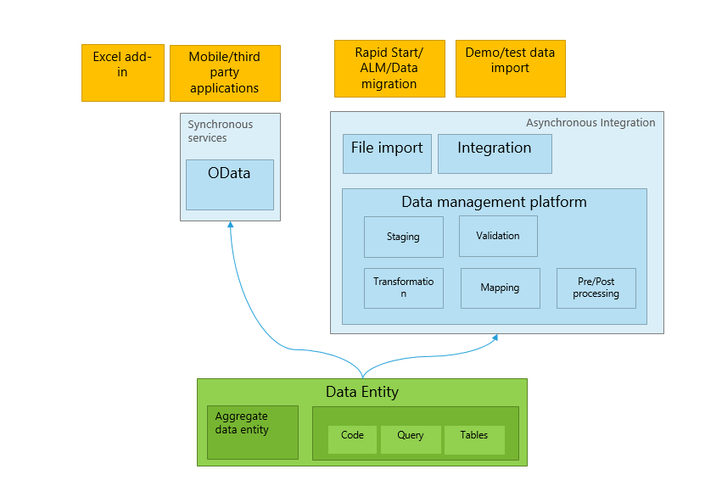
Key Components and Data Architecture - DMF

Slide 14
Key Components and Data Architecture - OData
Data entities from the DMF can be exposed to a REST endpoint with AAD OAuth.
Entities in the AOT that are set to public are also OData entities.
Quick, easy, sometimes codeless integration
Support for basic CRUD operations for thousands of entities OOTB
Sometimes slow
Postings generally not supported
Throttling Can Occur

Slide 15
Key Components and Data Architecture – Excel Add-in
It’s Excel
Similar to OData because it is Odata
Can paste data into Excel then upload it
Also can paste directly into grids now too

Slide 16
Key Components and Data Architecture – Custom Services
Powerful and flexible
Support CRUD operations as well as posting of transactions
X++ based, you build to suit
Replacement for AIF services from older versions
XML and JSON formats with AAD OAuth

Slide 17
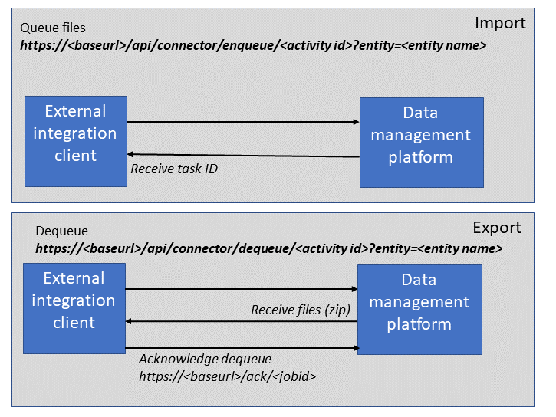
Key Components and Data Architecture – DMF API
DMF but via an API
Programmatic way of interactive with the DMF
Only data packages are supported for import and export
Largely like DMF otherwise

Slide 18
Data Migration Challenges

Slide 19

Common pitfalls and issues
Data Quality Issues
Data Mapping Errors
Inadequate Planning
Lack of Testing
Downtime Required
Stake Holder Involvement
Not assigning dollars to outcome

Slide 20
Data Management Framework (DMF)

Slide 21
Features and capabilities
Core of lots of integration tech
Interactive in F&O way to import and export data
Works for small or large files
Works with multiple formats
CSV, Excel, XML
No JSON, Parquet, other big data formats
Can be incremental for data import or export
Use artifacts called data entities
Data entities are a collection of tables that represent a concept in business

Slide 22
Features and capabilities
Core of lots of integration tech
Interactive in F&O way to import and export data
Works for small or large files
Works with multiple formats
CSV, Excel, XML
No JSON, Parquet, other big data formats
Can be incremental for data import or export
Use artifacts called data entities
Data entities are a collection of tables that represent a concept in business

Slide 23
The Good, The Bad, and The Metal
The Good
The Bad
Suitable for large data integrations
Incremental data import/export possibility
Staging tables for data validation
Can be used in lots of interactive/different scenarios
No support for modern big data formats
UI is not user friendly and confusing
Table lock problems, parallel executions will fail for the same data entity although async import like this is possible
Performance can be disappointing

Slide 24
Best For
Interactive data import
Interactive data exports
Data migration
Notes:
Data migration band

Slide 25
DMF Also Includes OData
Data entities from the DMF can be exposed to a REST endpoint with AAD OAuth.
Entities in the AOT that are set to public are also OData entities.
Quick, easy, sometimes codeless integration
Support for basic CRUD operations for thousands of entities OOTB
Sometimes slow
Postings generally not supported
Throttling Can Occur

Slide 26
Plus the Excel Add-In
It’s Excel
Similar to OData because it is Odata
Can paste data into Excel then upload it
Also can paste directly into grids now too
Notes:
Odata metal band

Slide 27
DMF API
DMF but via an API
Programmatic way of interactive with the DMF
Only data packages are supported for import and export
Largely like DMF otherwise

Slide 28
DMF API
The Good
The Bad
Same as DMF
Can be used to get large quantities of data in and out without relying on a UI
Can be used to stage import/exports
Same as DMF
Table lock problems
Parallel executions will fail for the same data entity although async import is possible

Slide 29
Data Migration Framework Use Cases
Integrations
BI
Mobile
Configurations
Import/Export data
DMF
Data
Migration
Office
Integration
Apps

Slide 30
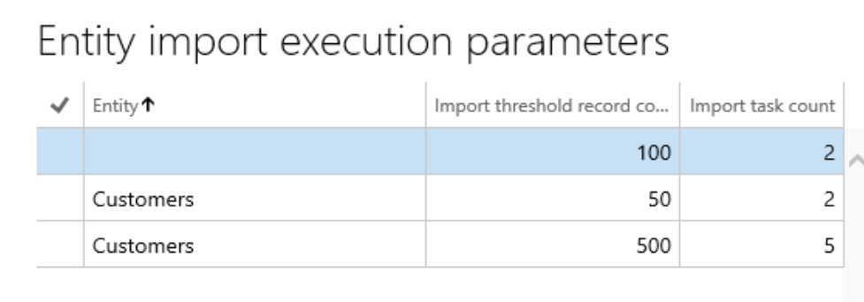
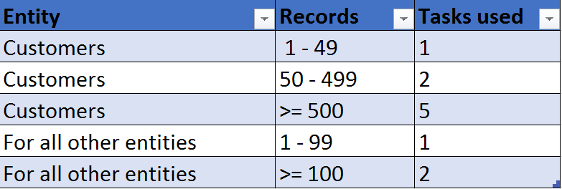
High Volume Data Migration - Bundling
Framework Parameters => Entity Settings => Configure entity execution parameters
Entity: If this is left blank, it is used as a global setting for all entities.
Import threshold record count: The number of import records for which the task count applies.
Import task count: The number of parallel task count
Different thresholds even for same entity
Works only with Batch and not in Async/Ad-hoc import
System administration->Setup ->Server configuration
Review number of threads
During migration you can go up to 16 threads

Slide 31
Best practices
Know your data volumes
Know your available throughput
Know what’s in golden config and what is not
Maybe list all data elements / entities in your plan with a “path forward”
Order of Operations Matters

Slide 32
Use cases
Use a Logic App to iterate over Spreadsheets in SharePoint to create/update records in code tables using OData
Use Excel Add-in to upload values into a code table
Use Azure Data Factory to pull values from a legacy database and submit csv to recurring integration endpoint for batch processing

Slide 33
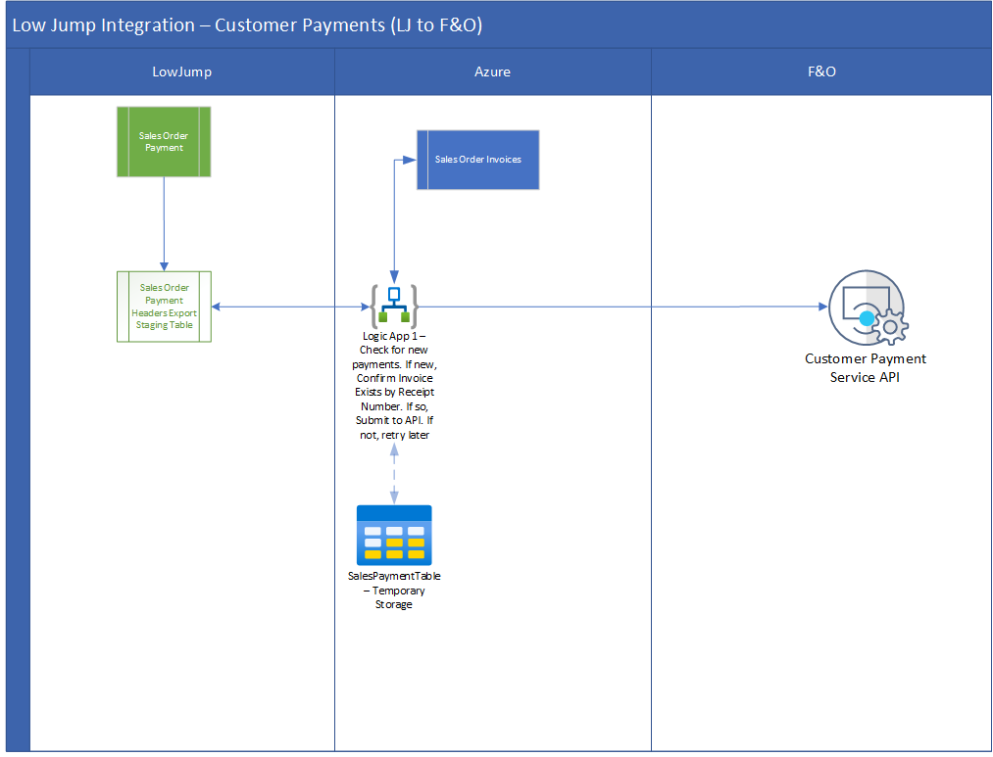
Use cases

Slide 34
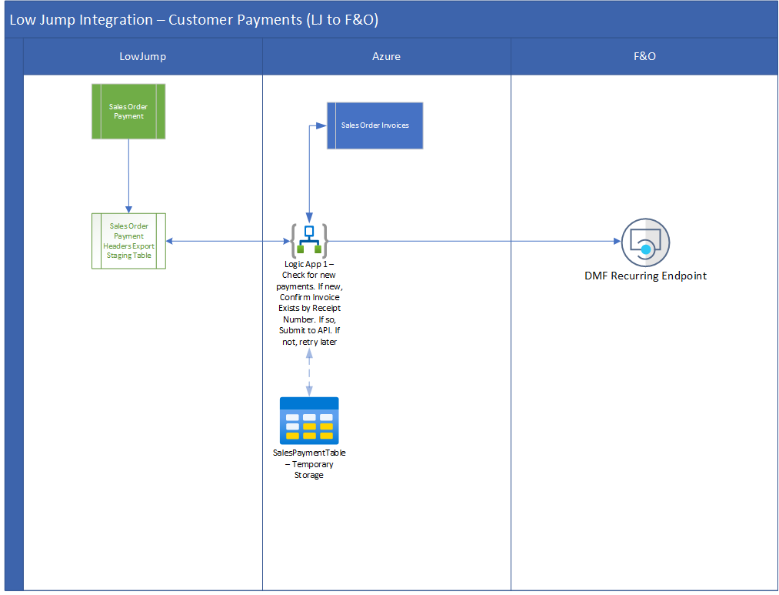
Use cases

Slide 35
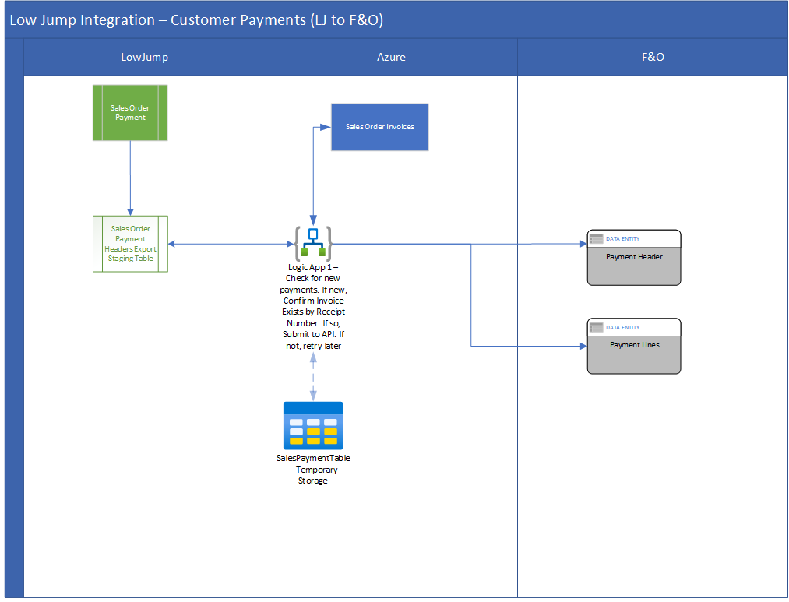
Use cases

Slide 36
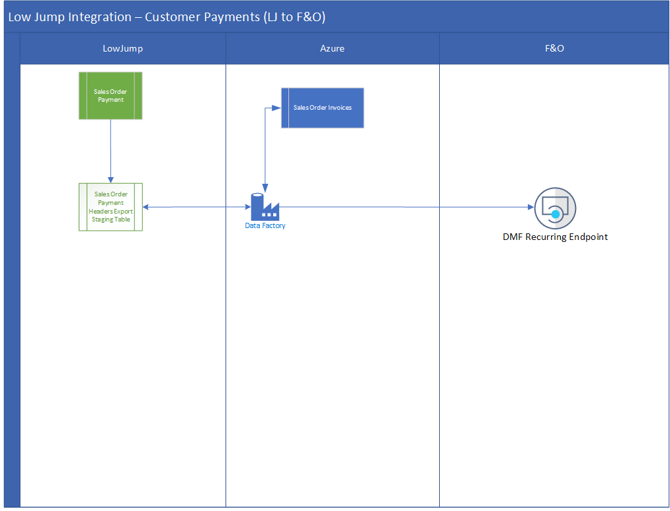
Use cases

Slide 37
APIs for Data Management

Slide 38
Types of APIs
Soap and REST
Custom Services
Can do posting or anything you want them to do since you’d have to build them

Slide 39
Custom Services
The Good
The Bad
Flexible and customizable
High performance*
Support CRUD and postings
JSON and XML endpoints automagically
Could use Azure API Manager
May not work with large* data transfers
X++ based
Requires experienced developer
No management or monitoring in F&O
May have to use Azure API Manager

Slide 41
Implementing and Utilizing APIs
Need to understand what data are going where when and in what order
Example
Customer Groups
Customers
Item Model Groups
Released Products
Sales Order Headers
Sales Order Lines

Slide 42
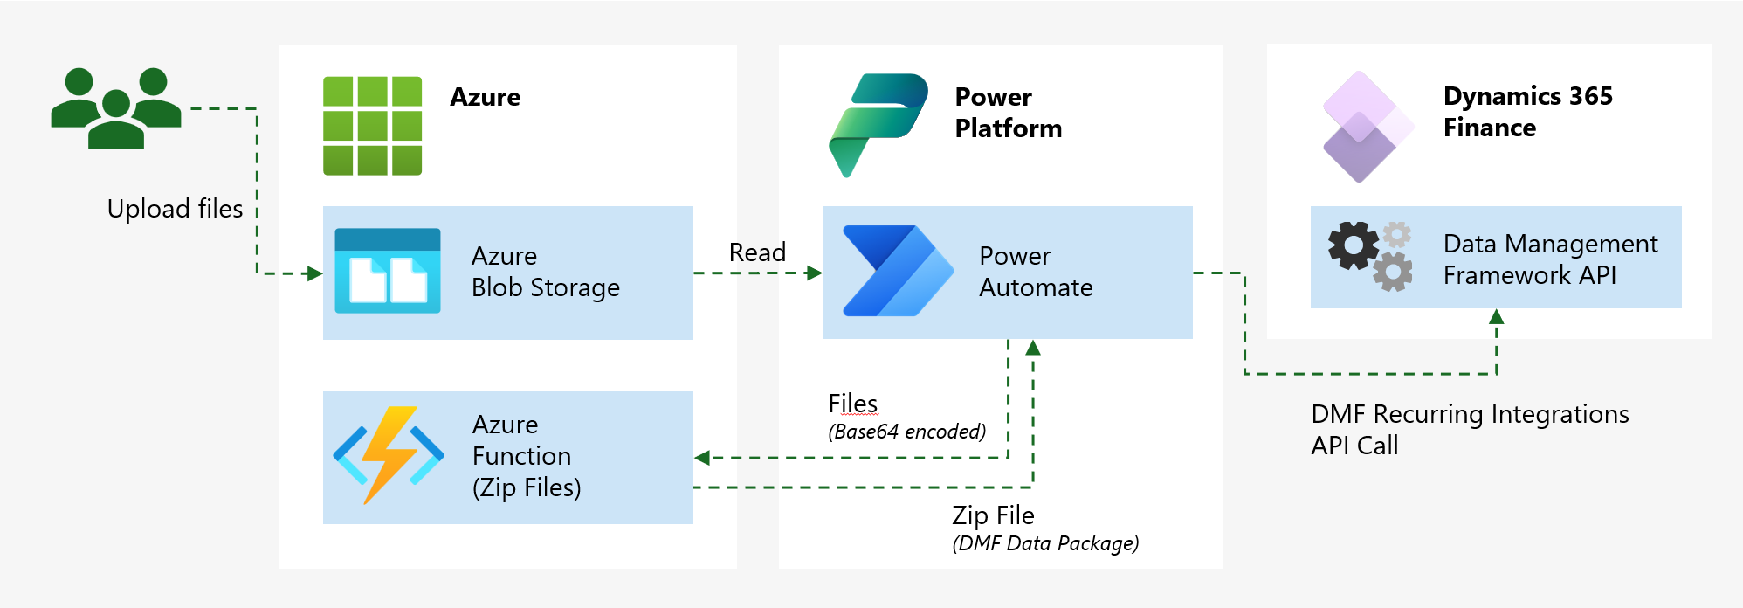
Implementing and Utilizing APIs
Notes:
https://www.jaestevan.com/blog/2024/low-code-custom-data-import-in-dynamics-365-finance-and-operations/

Slide 43
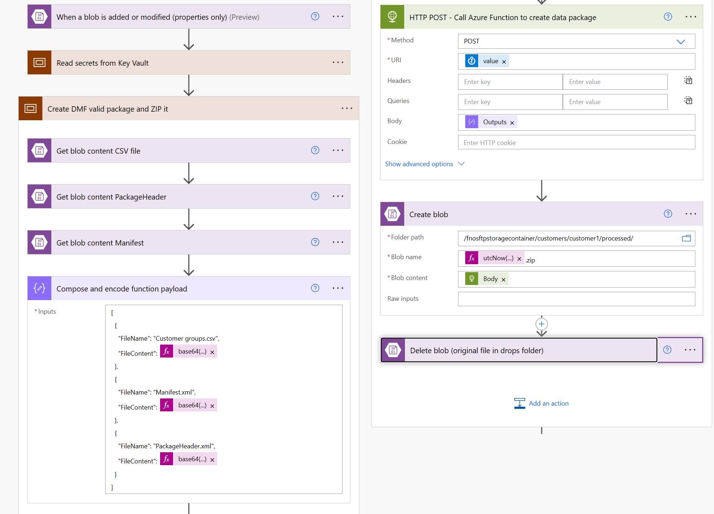
Implementing and Utilizing APIs
Notes:
https://www.jaestevan.com/blog/2024/low-code-custom-data-import-in-dynamics-365-finance-and-operations/

Slide 44
Notes:
https://www.jaestevan.com/blog/2024/low-code-custom-data-import-in-dynamics-365-finance-and-operations/

Slide 45
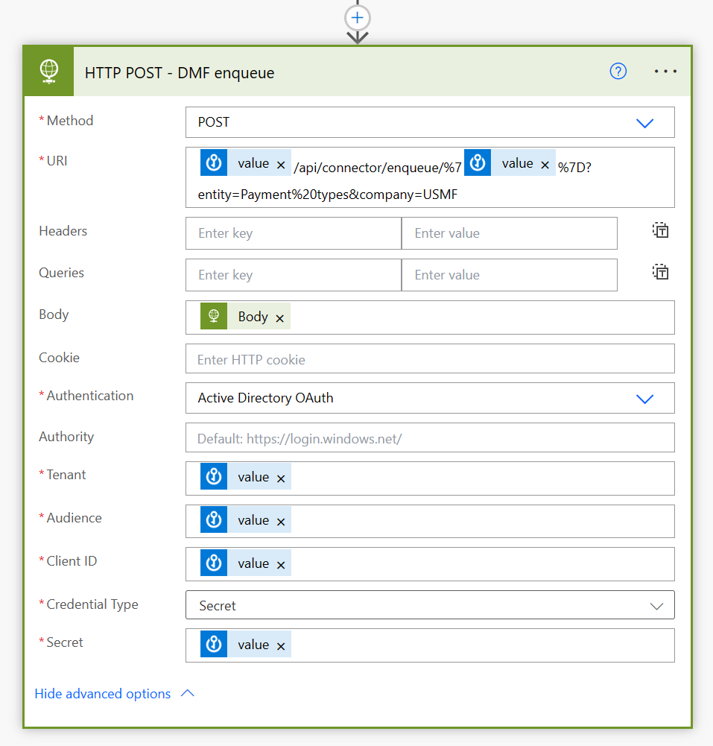
Implementing and Utilizing APIs
Notes:
https://www.jaestevan.com/blog/2024/low-code-custom-data-import-in-dynamics-365-finance-and-operations/

Slide 46
Recurring Integrations

Slide 47
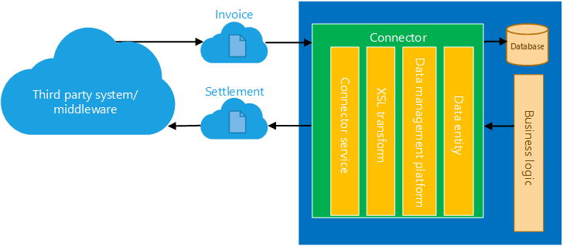
Setting and managing recurring data transfers

Slide 48
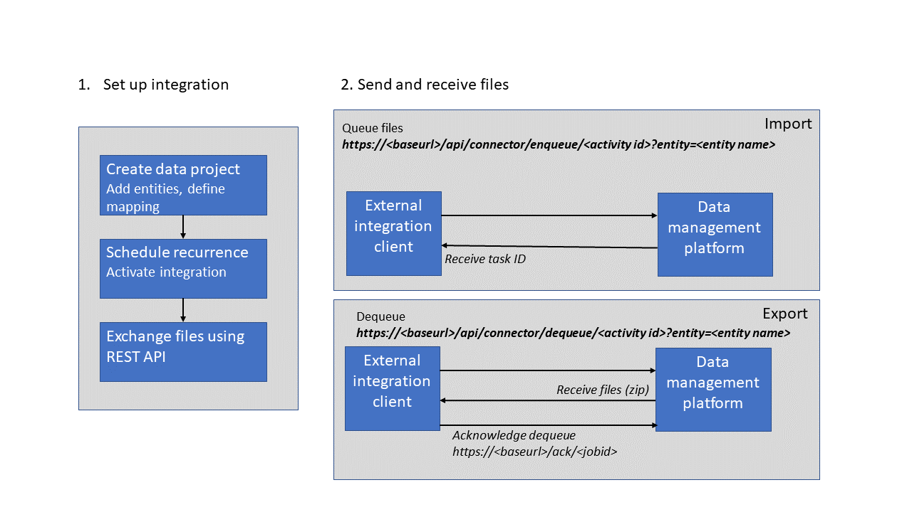
Setting and managing recurring data transfers

Slide 49
Benefits and examples
Builds on all the DMF goodness
Allows for exchange of documents over time
Secure
“Eventually Stateful” – Think of it like email

Slide 50
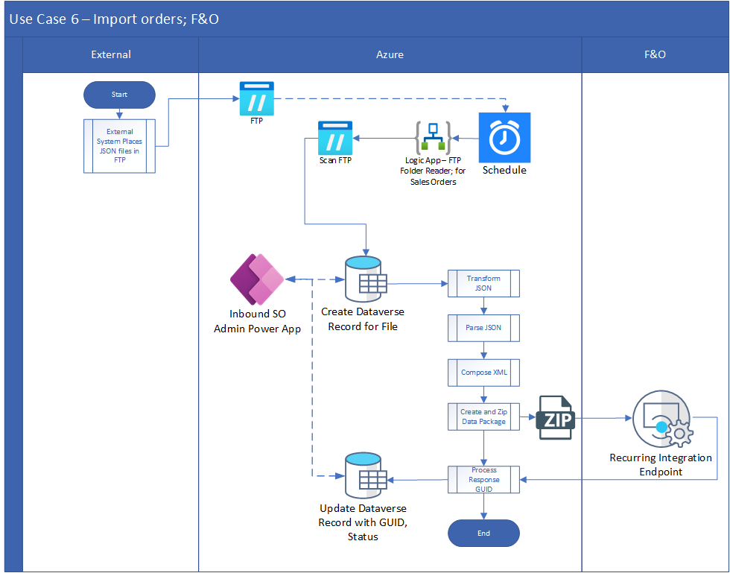
Benefits and examples

Slide 52
Logic Apps and Automation

Slide 53
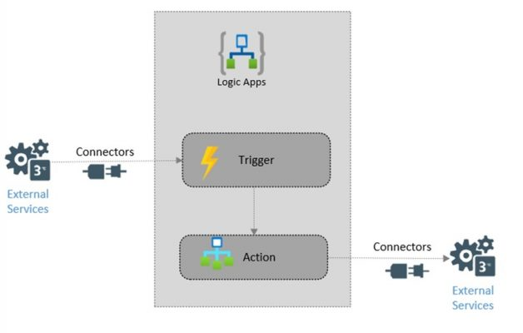
Introduction to Logic Apps

Slide 54
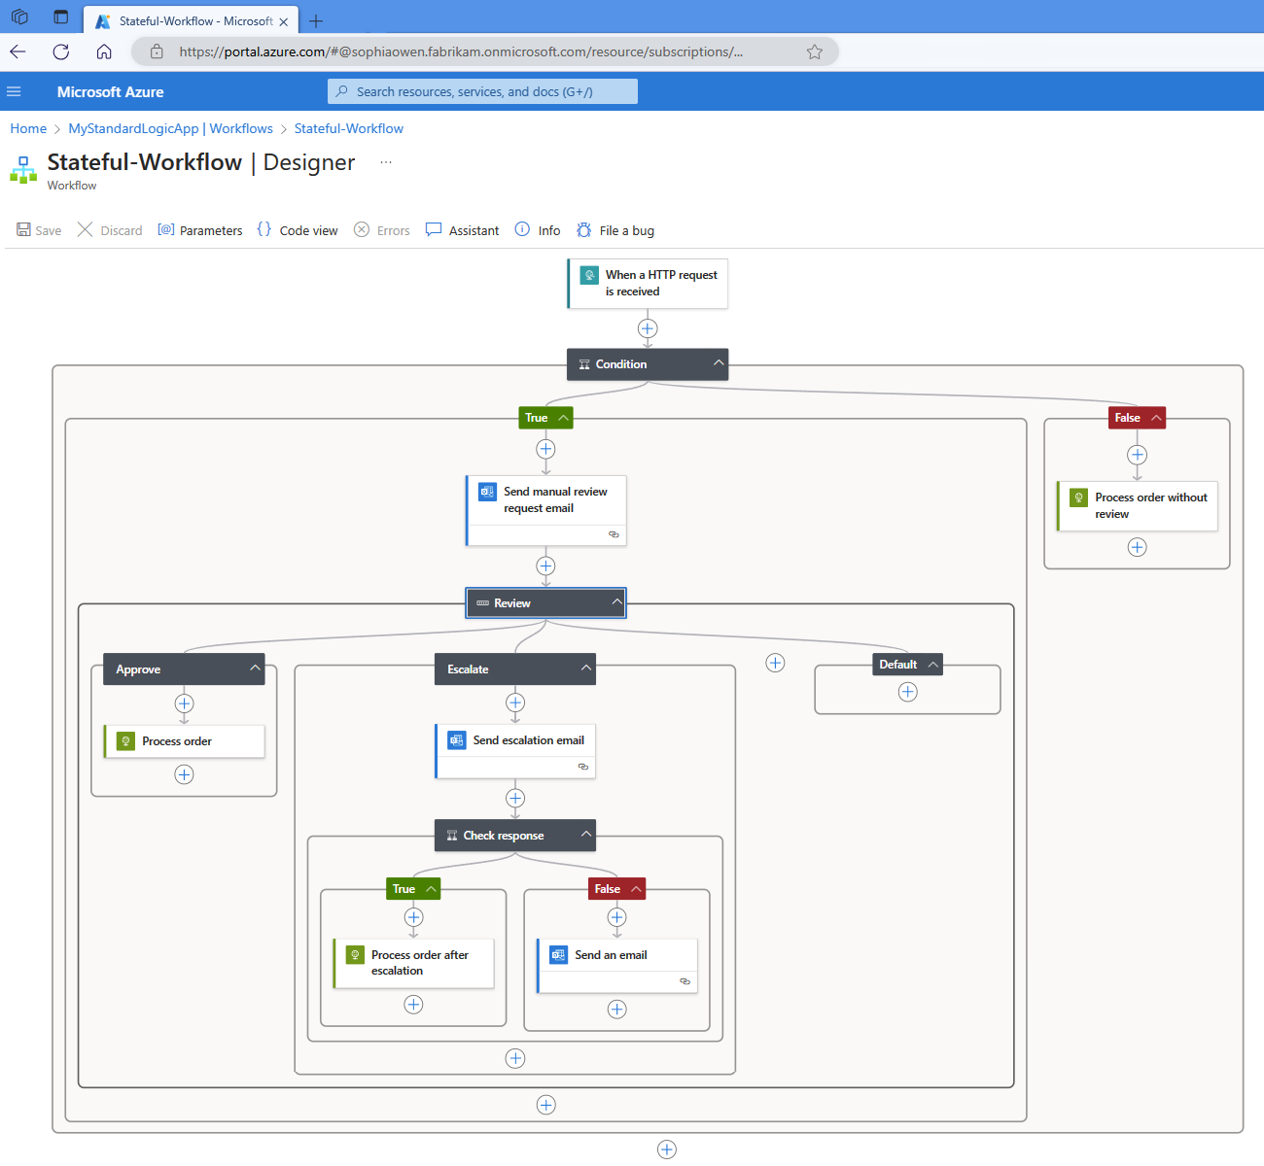
Introduction to Logic Apps

Slide 55
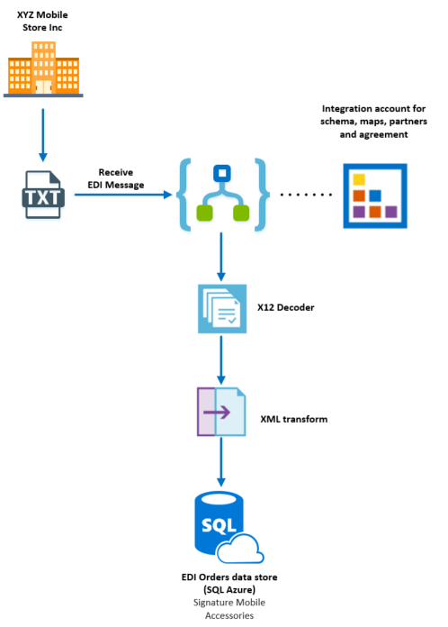
Creating automated workflows
Notes:
https://vnbconsulting.com/2018/03/develop-end-to-end-b2b-edi-supply-chain-solution-with-azure-logic-apps-part-2/

Slide 56
OData for Real-Time Data Access

Slide 57
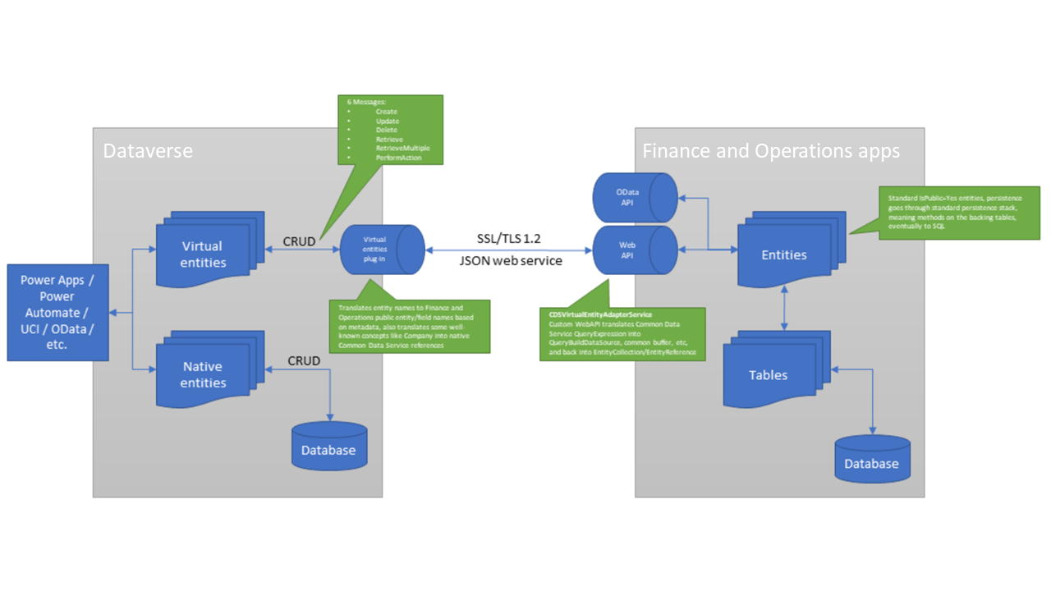
Overview of OData

Slide 58
Overview of OData

Slide 59
OData – The Good, The Bad, and the Metal
The Good
The Bad
Easy to use / consume
Lots of OOTB Data entities that support CRUD operations
Plugs into other platforms easily
Custom Actions / methods
Slow queries sometimes
Slow CRUD operations sometimes
Postings generally not supported
Throttling can occur

Slide 60
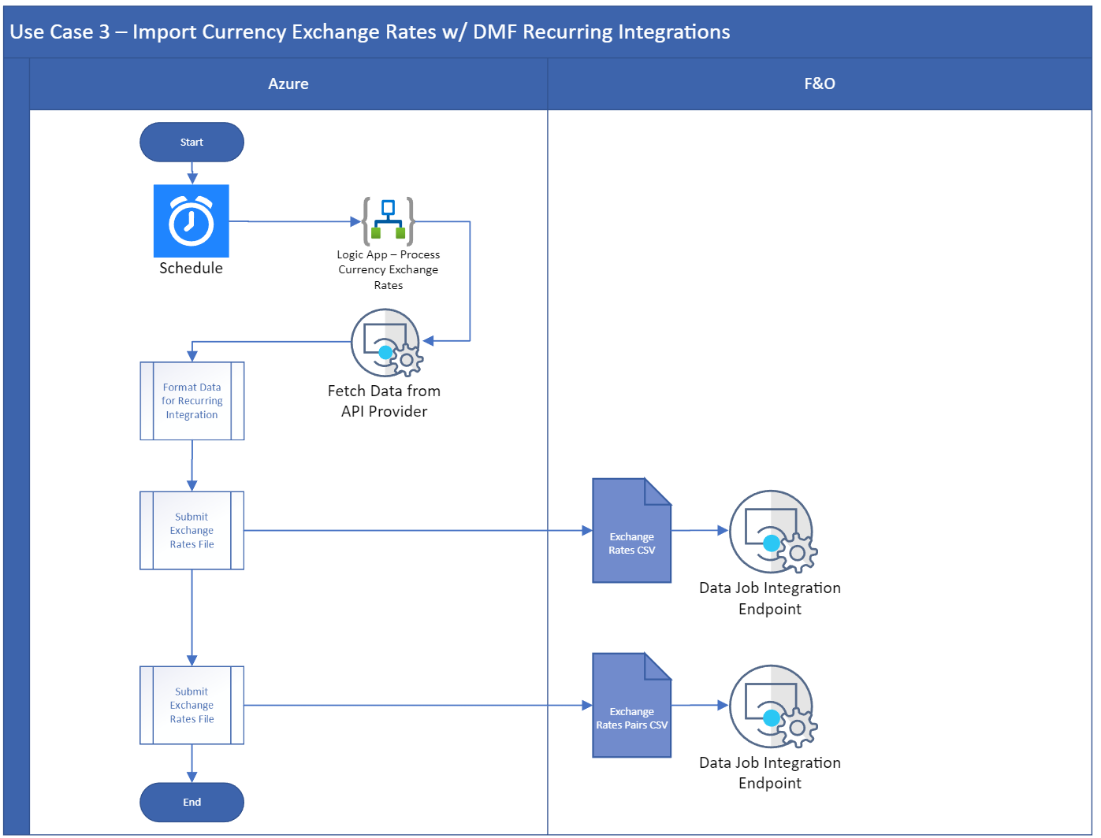
Practical applications in data migration

Slide 61
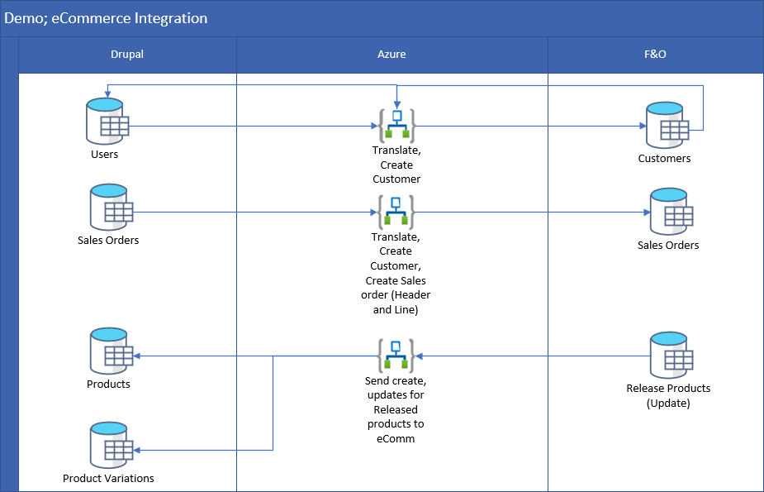
Practical applications in data migration

Slide 62
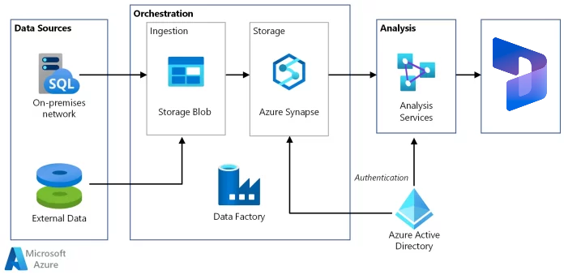
Don’t Forget Azure Data Factory

Slide 63
Synchronizing Data

Slide 64
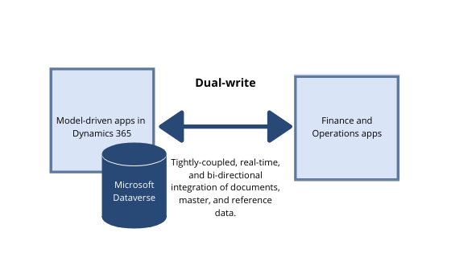
Understanding Dual-Write

Slide 65
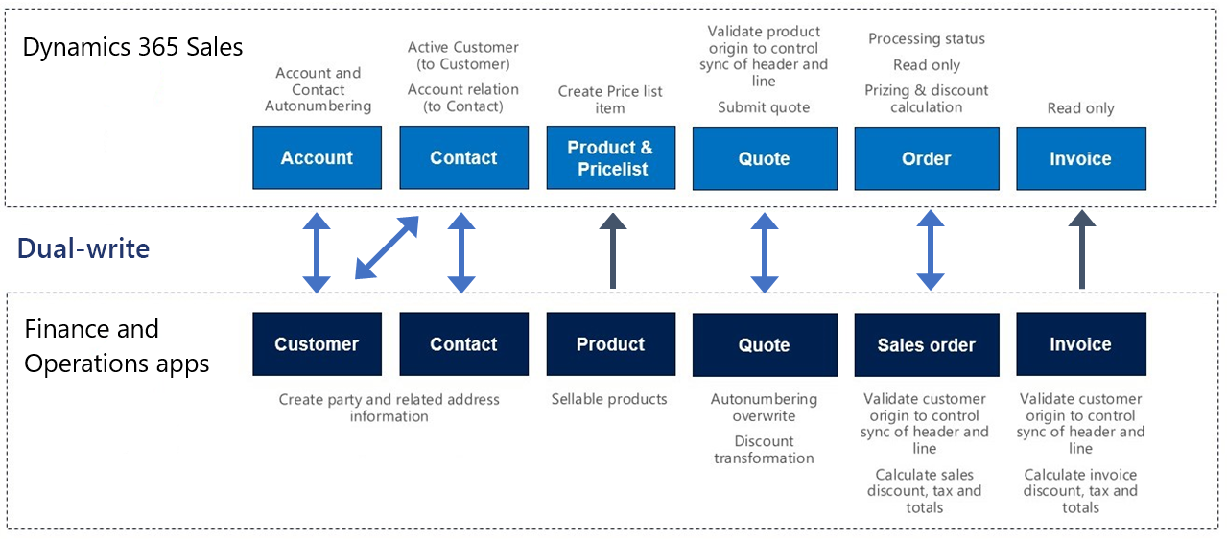
Understanding Dual-Write

Slide 66
Understanding Dual-Write
In the context of Data Migration…
Part of your data migration, the last part (probably)
Must pick something to get the data first then distribute it from there

Slide 67
Scenarios and Recommended Practices

Slide 68
Cross-Company Data Sharing Overview
Concepts
Duplicated record sharing (DRS)
Master company sharing (Single record sharing (SRS))
Why?
Consistent customer data
Configuration alignment
Centralized maintenance
Data sharing policies
Mode
Tables and fields
Companies
Notes:
Duplicate Record Sharing (DRS):
In DRS, creating, updating, or deleting records for any company in the policy is copied/replicated across all companies in the policy.
Updates of fields are replicated if selected for sharing in the policy.
DRS was the first sharing type made available.
Master Company Sharing (Single Record Sharing, SRS):
In SRS, a single physical record belonging to a master company is virtually shared across child companies.
When you create, update, or delete in any company within the policy, it updates the single records used across all companies.
Master company sharing is currently in preview.
Why Consider Cross-Company Data Sharing?
You should consider cross-company data sharing if you need consistent data across more than one company in a deployment. Here are some examples of business scenarios where cross-company data sharing is beneficial:
Consistent Customer Data:
Ensure that all customers are available for service and have the same terms across all companies.
Maintain consistent payment and delivery terms across all companies per region.
Configuration Alignment:
Align configuration settings (such as cash and bank management parameters) to ensure consistent processing across all companies.
Centralized Maintenance:
Use roles and security configuration to centralize maintenance of shared tables by providing permissions to selected users in specific companies.
Data Sharing Policies
Data sharing is managed through defined policies saved in data packages. These policies allow you to control the following aspects of data sharing:
Data Sharing Concept: Choose between duplicate record sharing (DRS) and master company sharing (SRS).
Shared Tables: Specify which tables are shared.
Shared Fields: Select the fields that are shared.
Participating Companies: Define the companies that participate in the sharing.
Remember that the same company and table can only be in one enabled policy, but you can share the same table in multiple policies if needed.
Important Considerations
Limits: Be aware of the limits regarding the number of records and companies stated above.
Master Company Sharing: Once master company sharing is enabled, there’s no way to reduce the scope or stop sharing

Slide 69
Data Sharing Framework
Policy
Environment 1
Environment 2
Policy A
Policy A
Tables
Fields
Legal Entity Scope
Tables
Fields
Legal Entity Scope
Tables
Fields
Legal Entity Scope
Data Entity
Policy B
Policy B
Tables
Fields
Legal Entity Scope
Tables
Fields
Legal Entity Scope
Policy C
Policy C
Tables
Fields
Legal Entity Scope
Tables
Fields
Legal Entity Scope

Slide 70
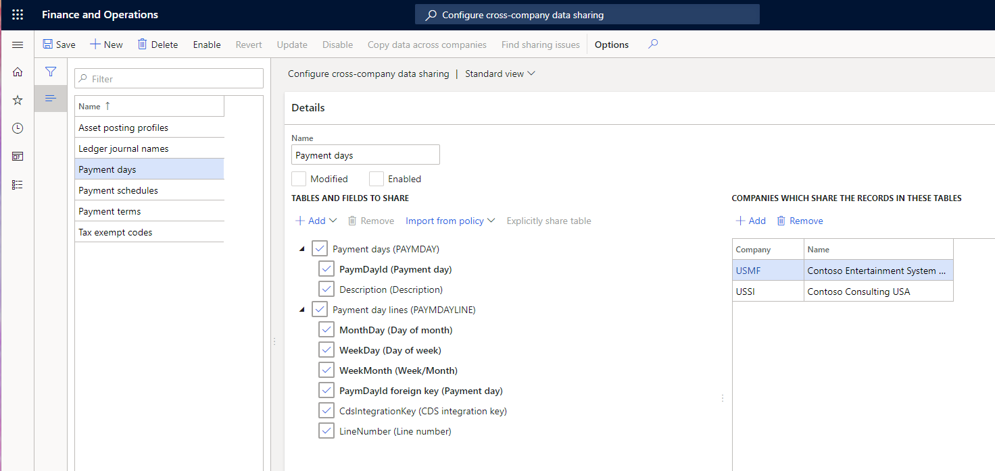
Configure cross-company data sharing

Slide 71
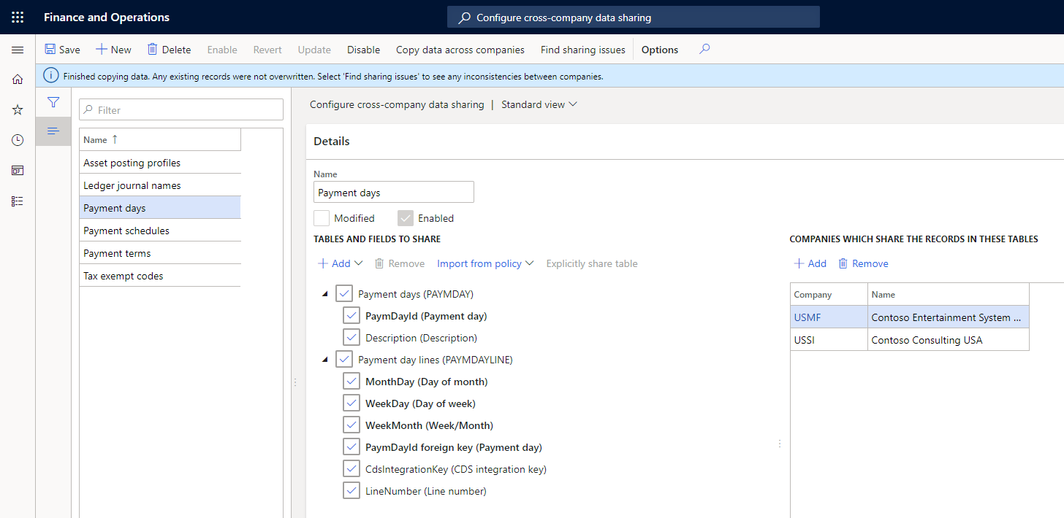
Configure cross-company data sharing setup

Slide 72
Data Sharing Framework Recommendations
Replicate (share) reference and group data between companies within an environment
Data integrity is verified prior to replication
Not a replacement for virtual company, this is a new implementation for data sharing.
Limitations
It can’t be used to share transactional data between companies.
Only reference, parameters and group data can be shared
It supports replicating fewer than two million total records per job (calculated as the number of shared records * number of shared companies)

Slide 73
Data Preparation and Cleansing

Slide 74
Importance of data quality
Data Quality
Accurate, complete, and reliable data is crucial for effective decision-making.
System Performance
Clean data enhances the performance and efficiency of Dynamics 365.
User Trust
Consistent and correct data builds trust among users.
Compliance
Ensures adherence to regulatory standards and avoids penalties.
Cost Savings
Reduces the costs associated with data errors and rework.

Slide 75
Common data issues
Duplicates
Inconsistencies
Incomplete data
Outdated information
Incorrect data
Notes:
Duplicates: Multiple entries of the same data.
Inconsistencies: Conflicting data values.
Incomplete Data: Missing critical information.
Outdated Information: Stale data no longer relevant.
Incorrect Data: Data errors due to manual entry or migration issues.

Slide 76
Data Preparation and Cleansing Overview
Preparation
Cleansing
Data collection
Data integration
Data formatting
Data transformation
Data profiling
Error detection
Data correction
Data validation
Notes:
Introduction:
"Data preparation and cleansing are foundational steps in data management, ensuring that the data used in Dynamics 365 is accurate, consistent, and reliable."
Data Preparation:
Definition:
"Data preparation involves gathering, combining, structuring, and organizing data so it can be analyzed effectively."
Key Steps:
"Data collection: Gathering data from various sources."
"Data integration: Combining data into a single dataset."
"Data formatting: Structuring data into a usable format."
"Data transformation: Converting data to meet specific requirements."
Data Cleansing:
Definition:
"Data cleansing, or data cleaning, is the process of detecting and correcting (or removing) corrupt or inaccurate records from a dataset."
Key Steps:
"Data profiling: Analyzing data to understand its quality and structure."
"Error detection: Identifying issues like missing values, duplicates, and inconsistencies."
"Data correction: Fixing errors, standardizing formats, and removing duplicates."
"Data validation: Ensuring the cleaned data meets required standards."
Importance of Both Processes:
"Both data preparation and cleansing are crucial for maintaining high data quality. They improve the accuracy and reliability of data, enhance system performance, and ensure that data-driven decisions are based on solid information."
"Effective data management also supports regulatory compliance, reduces operational costs, and builds user trust in the data."

Slide 77
Tools for Data Preparation and Cleansing
Microsoft Power Query
Data Management Framework (DMF)
Azure Data Factory
Third-party tools
Notes:
There are various tools available that can assist in the data preparation and cleansing process. These tools help automate and streamline the tasks involved, making the process more efficient and less prone to human error."
Microsoft Power Query:
"Microsoft Power Query is a powerful data connection technology that enables users to discover, connect, combine, and refine data across a wide variety of sources. It's integrated with Excel and Power BI, making it accessible for many users."
"With Power Query, you can perform tasks such as removing duplicates, filtering data, and transforming data into the required format."
Data Management Framework (DMF) in Dynamics 365:
"The Data Management Framework in Dynamics 365 provides tools for importing, exporting, and managing data within the system. It includes features for data validation, transformation, and cleansing."
"DMF helps ensure that data imported into Dynamics 365 meets the required quality standards, reducing errors and inconsistencies."
Azure Data Factory:
"Azure Data Factory is a cloud-based data integration service that allows you to create, schedule, and orchestrate ETL (Extract, Transform, Load) workflows. It can handle large-scale data preparation and cleansing tasks."
"It supports a wide range of data sources and offers robust transformation capabilities, making it ideal for complex data management scenarios."
Third-party Tools:
"In addition to Microsoft's own tools, there are several third-party solutions that offer advanced data preparation and cleansing functionalities. Tools like Talend, Informatica, and Trifacta are popular choices."
"These tools provide comprehensive data profiling, transformation, and cleansing capabilities, often with intuitive interfaces and powerful automation features."
Choosing the Right Tool:
"The choice of tool depends on the specific needs of your organization, the complexity of your data, and the existing technology stack. It's important to evaluate the features, ease of use, and integration capabilities of each tool.

Slide 78
Migration Planning and Execution

Slide 79
Creating a migration plan
Overview
Business Process Oriented Planning
Using the Catalog
Critical for implementing
Meet operational needs
Holistic view
Ensure data integrity
Align with business priorities
Prioritization
Minimize downtime
Identify business critical data
Consistency
Align with business processes
Notes:
Introduction:
"Data migration is a critical process in implementing Dynamics 365, involving the transfer of data from existing systems to the new platform."
"A well-structured migration plan ensures data integrity, minimizes downtime, and aligns with business processes."
Importance of Aligning with Business Processes:
"Aligning data migration with business processes ensures that the new system supports organizational workflows and operational needs."
"This approach helps identify the most critical data and establishes the migration sequence based on business priorities."
Steps for Business Process-Oriented Planning:
Assess Current Business Processes:
"Evaluate existing workflows and data dependencies to understand how data supports operations."
Define Future State:
"Determine how business processes will function in Dynamics 365 and identify any changes or improvements needed."
Map Data Requirements:
"Align data fields and structures in the current system with those in Dynamics 365, ensuring all necessary data is captured."

Slide 80
Executing and monitoring data migration
Migration execution
Monitoring and validation
Post migration
Data extraction
Data transformation
Data loading
Continuous monitoring
Validation checks
User acceptance testing
User training
Data reconciliation
Ongoing support

Slide 81

Combine Frameworks and tools to Optimize
Golden Configs
Complete
Golden Configs
Restore complete
Master Data
Import complete
Opening Balances
Import complete
Mock cutover
Complete
Cutover
Complete
First go-live
c
Data
Packages/
Manually
Configured
DB
restore
Data Packages/
Integrations
Data Entities
Testing /
Validation
Live
Golden
Cutover
Gold Env
Production Environment
Cycle
1st Milestone
2nd Milestone
3rd Milestone
4th Milestone
Golden Configs
Golden Configs + Master Data
Golden Configs + Master Data +
Beginning Balances
Golden Configs
Complete
Golden Configs
Restore complete
Master Data
Import complete
Opening Balances
Import complete
Incremental go-lives
Data
Packages/
Manually
Configured
Data Packages/
Integrations
Live
Golden
Data packages
Copy into new LE
Data Entities
Gold Env
Production Environment
Notes:
Explain the advantages of Data Packages compared to a DB copy scenario based on the stage of the project
Data restore is support to quickly move data from Golden to UAT or Prod but this approach is valid only for the first go-live of the project
For phased implementations where projects requires to add new legal entities or increase the functional footprint data entities are the option
A good plan on data entities since the start will avoid bottlenecks down the road
The approach proposed on the graphic above also provides the capability to use snapshots, this are Point In Tim Restore capabilities just for environments with SQL Azure DB (Tier 2)
The Snapshots allows to reset the DB to a date and time and reuse work done for additional rounds, this increase speed on deployments
This process should be uses just during the final testing and can use Production Environment for that
Using prod for this last test allows also to validate expected performance and seed final configurations on integrations, BI, etc.

Slide 82
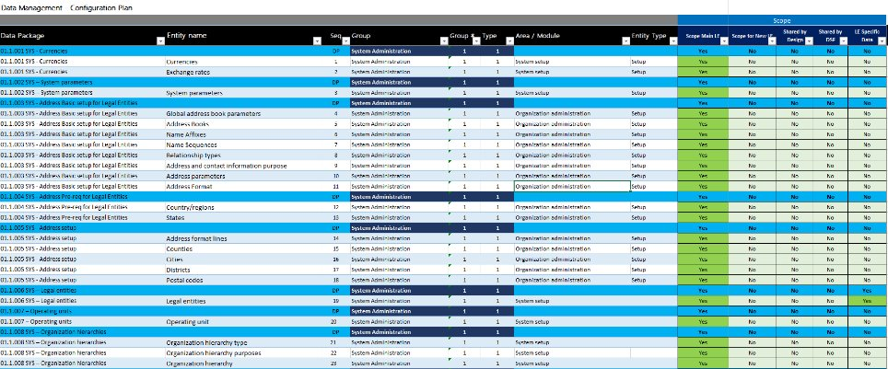
The Data Migration Runbook

Slide 83
Testing and Validation
Notes:
Testing and validating data migration are crucial steps to ensure the success of a Dynamics 365 implementation."
"The focus is on ensuring data integrity and utilizing effective testing tools and strategies to confirm that data has been accurately migrated.

Slide 84
Ensuring data integrity
Accuracy
Consistency
Completeness
Timeliness
Notes:
Definition and Importance:
"Data integrity refers to the accuracy, consistency, and reliability of data throughout its lifecycle."
"Maintaining data integrity during migration ensures that business processes function correctly and that users can trust the data in Dynamics 365."
Key Aspects of Data Integrity:
Accuracy:
"Ensure that all data is correct and matches the source data."
Consistency:
"Verify that data is uniformly represented across all records and systems."
Completeness:
"Confirm that no data is missing and all necessary information has been migrated."
Timeliness:
"Ensure that data is up-to-date and reflects the most current information available."

Slide 85
Test strategies and tools
Tools
Data Migration Framework
Power BI
Azure Data Factory
Third-party tools
Strategies
Data mapping validation
Sample data testing
End-to-end testing
User Acceptance testing
Notes:
Testing Tools:
Microsoft Data Management Framework (DMF):
"Use DMF to perform data import/export operations and validate data during the migration process."
Microsoft Power BI:
"Leverage Power BI to create reports and dashboards that help visualize and validate migrated data."
Azure Data Factory:
"Utilize Azure Data Factory for ETL processes and to ensure data quality during migration."
Third-Party Tools:
"Consider third-party data validation tools like Talend and Informatica for advanced data profiling and validation."
Testing Strategies:
Data Mapping Validation:
"Ensure that all data fields in the source system are correctly mapped to the corresponding fields in Dynamics 365."
Sample Data Testing:
"Perform initial testing with a subset of data to identify and resolve issues before full-scale migration."
End-to-End Testing:
"Conduct comprehensive testing across the entire data flow, from source to target system, to ensure all processes function as expected."
User Acceptance Testing (UAT):
"Engage end-users in testing to validate that the data supports business processes and that users can perform their tasks accurately."

Slide 86
Validation techniques and recommended practices
Validation
Recommendations
Record counts
Data sampling
Automated scripts
Reconciliation reports
Early and frequent testing
Cross-functional collaboration
Document and track issues
Iterative approach
Notes:
Validation Techniques:
Record Counts:
"Compare the number of records in the source and target systems to ensure all data has been migrated."
Data Sampling:
"Randomly select and verify data samples to check for accuracy and consistency."
Automated Scripts:
"Use automated scripts to validate data formats, relationships, and constraints."
Reconciliation Reports:
"Generate reports to reconcile migrated data with source data, identifying discrepancies and ensuring completeness."
Best Practices:
Early and Frequent Testing:
"Start testing early in the migration process and perform it frequently to catch and resolve issues promptly."
Cross-functional Collaboration:
"Involve stakeholders from different business units to ensure comprehensive validation and alignment with business needs."
Document and Track Issues:
"Maintain detailed documentation of identified issues and their resolutions to improve the migration process."
Iterative Approach:
"Use an iterative approach to testing and validation, continuously refining and improving the process."

Slide 87
Wrap up

Slide 88
Related resources
Data entities
Data Management overview
Building and consuming data entities
Develop composite data entities
Develop an entity and use it for data migration
Copy configuration data from one company or legal entity to another
Database movement operations
Submit a request to the Dynamics Service Engineering team
Data task automation
Cross-company data sharing

